Slide 1
Object Oriented Programming ICT-1203
Dr. Jesmin Akhter
Associate Professor, IIT, JU

Slide 2
Exception Handling-2

Slide 3
throw
So far, you have only been catching exceptions that are thrown by the Java run-time system.
However, it is possible for your program to throw an exception explicitly, using the throw statement.
The general form of throw is shown here:
throw exception;
Let's see the example of throw IOException.
throw new IOException("sorry device error);

Slide 4
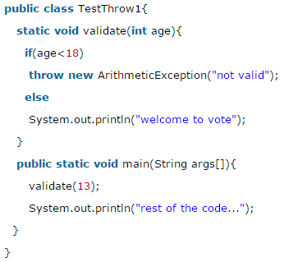
throw
Sample program that creates and throws an exception.
In this example, we have created the validate method that takes integer value as a parameter. If the age is less than 18, we are throwing the ArithmeticException otherwise print a message
Output:
Exception in thread main java.lang.ArithmeticException:not valid

Slide 5
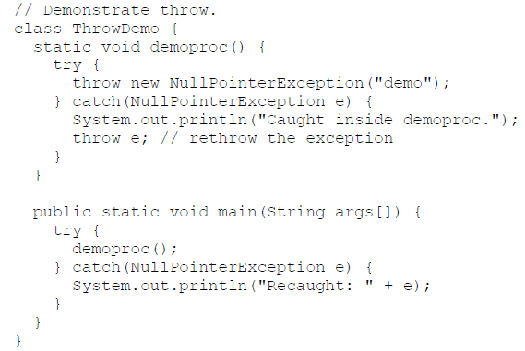
throw
Sample program that creates and throws an exception.

Slide 6
throw
This program gets two chances to deal with the same error. First, main( ) sets up an exception context and then calls demoproc( ).
The demoproc( ) method then sets up another exception-handling context and immediately throws a new instance of NullPointerException, which is caught on the next line.
The exception is then rethrown.
Here is the resulting output:
Caught inside demoproc.
Recaught: java.lang.NullPointerException: demo

Slide 7
throw
The program also illustrates how to create one of Java’s standard exception objects.
throw new NullPointerException("demo");
Here, new is used to construct an instance of NullPointerException.
Many of Java’s built-in run-time exceptions have at least two constructors: one with no parameter and one that takes a string parameter.
When the second form is used, the argument specifies a string that describes the exception. This string is displayed when the object is used as an argument to print( ) or println( ).

Slide 8
throws
If a method is capable of causing an exception that it does not handle, it must specify this behavior so that callers of the method can guard themselves against that exception.
You do this by including a throws clause in the method’s declaration.
A throws clause lists the types of exceptions that a method might throw.

Slide 9
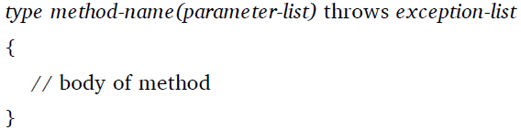
throws
This is the general form of a method declaration that includes a throws clause:
Here, exception-list is a comma-separated list of the exceptions that a method can throw.

Slide 10
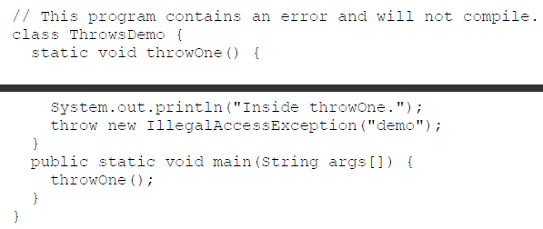
throws
Following is an example of an incorrect program that tries to throw an exception that it does not catch. Because the program does not specify a throws clause to declare this fact, the program will not compile.

Slide 11
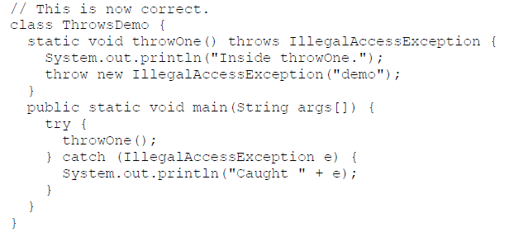
throws
To make this example compile, you need to make two changes. First, you need to declare that throwOne( ) throw IllegalAccessException. Second, main( ) must define a try / catch statement that catches this exception.
The corrected example is shown here:

Slide 12
throws
Here is the output generated by running this example program:
inside throwOne
caught java.lang.IllegalAccessException: demo

Slide 13
Assignment finally
Solve two example program
Explain those programs
Submit

Slide 14
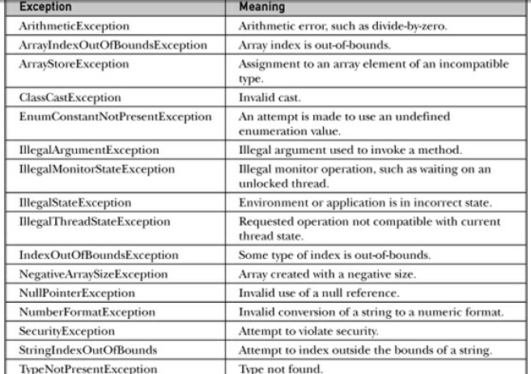
Java’s Built-in Exceptions
Inside the standard package java.lang, Java defines several exception classes.

Slide 15
Thank you

